Slide 1
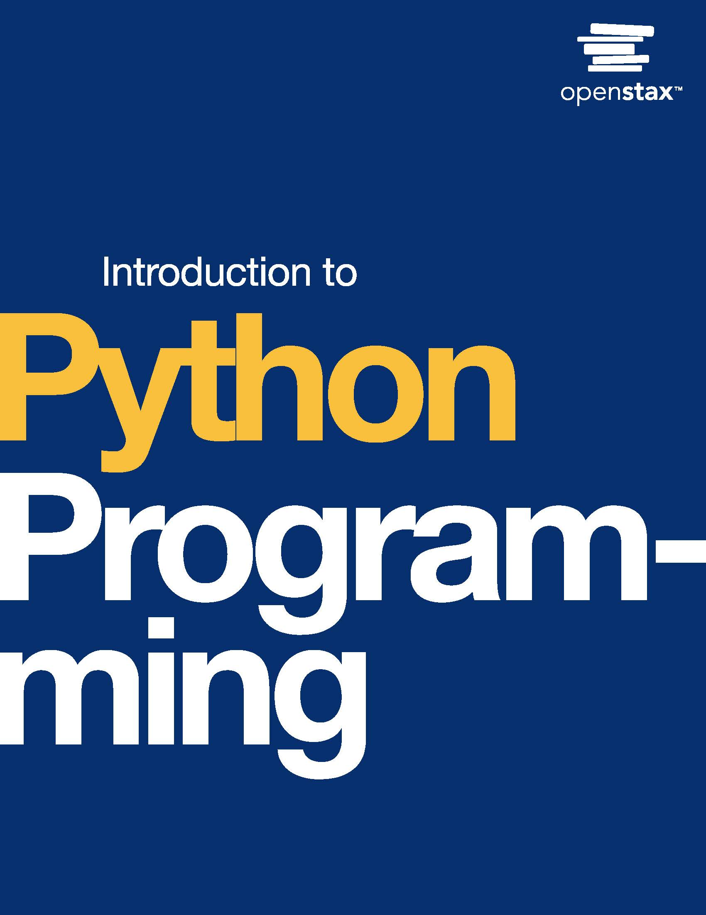
Introduction to Python Programming
Chapter 8: Strings

Slide 2
Chapter outline
String operations
String slicing
Searching/testing strings
String formatting
Splitting/joining strings

Slide 3

Figure 8.1
credit: modification of work "Project 366 #65: 050316 A Night On The Tiles", by Pete/Flickr, CC BY 2.0
Notes:
An image tiles held together with string, with characters written on tiles, reading "Illuminate"

Slide 4
8.1 String operations
Learning Objectives
Compare strings using logical and membership operators.
Use lower() and upper() string methods to convert string values to lowercase and uppercase characters.

Slide 5
8.1 String operations
String values can be compared using logical operators (<, <=, >, >=, ==, !=) and membership operators (in and not in).
When comparing two string values, the matching characters in two string values are compared sequentially until a decision is reached.
For comparing two characters, ASCII values are used to apply logical operators.

Slide 6
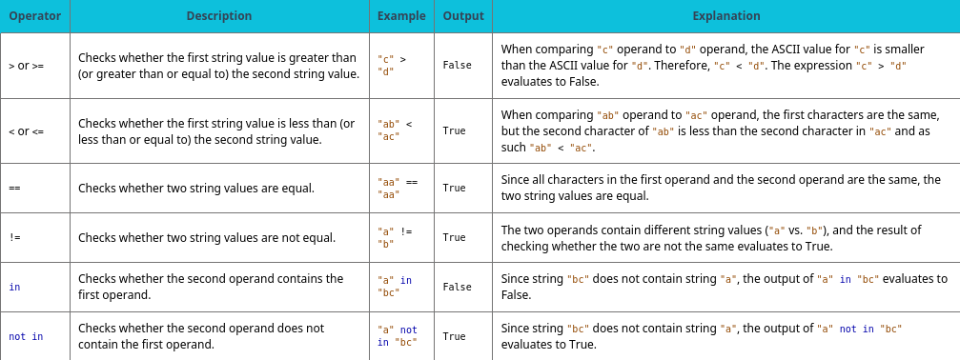
Table 8.1 Comparing string values.

Slide 7
8.1 String operations
lower() and upper()
The lower() method returns the converted alphabetical characters to lowercase
The upper() method returns the converted alphabetical characters to uppercase. Both the lower() and upper() methods do not modify the string.

Slide 8
8.2 String slicing
Learning Objectives
Use string indexing to access characters in the string.
Use string slicing to get a substring from a string.
Identify immutability characteristics of strings.

Slide 9
8.2 String slicing
A string is made up of a sequence of characters indexed from left to right, starting at 0.
For a string variable s, the left-most character is indexed 0 and the right-most character is indexed len(s) - 1.
Ex: The length of the string "Cloud" is 5, so the last index is 4.
Negative indexing can also be used to refer to characters from right to left starting at -1.
For a string variable s, the left-most character is indexed -len(s) and the right-most character is indexed -1.
Ex: The length of the string "flower" is 6, so the index of the first character with negative indexing is -6.

Slide 10
8.2 String slicing
String slicing is used when a programmer must get access to a sequence of characters. Here, a string slicing operator can be used.
When [a:b] is used with the name of a string variable, a sequence of characters starting from index a (inclusive) up to index b (exclusive) is returned.
Both a and b are optional. If a or b are not provided, the default values are 0 and len(string), respectively.

Slide 11
8.2 String slicing
String objects are immutable, meaning that string objects cannot be modified or changed once created.
Once a string object is created, the string's contents cannot be altered by directly modifying individual characters or elements within the string.
Instead, to make changes to a string, a new string object with the desired changes is created, leaving the original string unchanged.

Slide 12
8.3 Searching/testing strings
Learning Objectives
Use the in operator to identify whether a given string contains a substring.
Call the count() method to count the number of substrings in a given string.
Search a string to find a substring using the find() method.
Use the index() method to find the index of the first occurrence of a substring in a given string.
Write a for loop on strings using in operator.

Slide 13
8.3 Searching/testing strings
The in Boolean operator can be used to check if a string contains another string. in returns True if the first string exists in the second string, False otherwise.
The in operator can be used to iterate over characters in a string using a for loop. In each for loop iteration, one character is read and will be the loop variable for that iteration.

Slide 14
8.3 Searching/testing strings
The count() method counts the number of occurrences of a substring in a given string. If the given substring does not exist in the given string, the value 0 is returned.
The find() method returns the index of the first occurrence of a substring in a given string. If the substring does not exist in the given string, the value of -1 is returned.
The index() method performs similarly to the find() method in which the method returns the index of the first occurrence of a substring in a given string.
The index() method assumes that the substring exists in the given string; otherwise, throws a ValueError.

Slide 15
8.4 String formatting
Learning Objectives
Format a string template using input arguments.
Use format() to generate numerical formats based on a given template.

Slide 16
8.4 String formatting
Formatting string includes specifying string pattern rules and modifying the string according to the formatting specification.
Examples of formatting strings include using patterns for building different string values and specifying modification rules for the string's length and alignment.
Replacement fields are used to define a pattern for creating multiple string values that comply with a given format.

Slide 17
8.4 String formatting
Replacement fields can be tagged with a label, called named replacement fields, for ease of access and code readability.
Python's string format() method can use positional ordering to match the numbered arguments. The replacement fields that use the positional ordering of arguments are called numbered replacement fields.
The indexing of the arguments starts from 0.
Ex: print("{1}{0}".format("Home", "Welcome")) outputs the string value "Welcome Home" as the first argument. "Home" is at index 0, and the second argument, "Welcome", is at index 1.
Replacing these arguments in the order of "{1}{0}" creates the string "Welcome Home".
Numbered replacement fields can use argument's values for multiple replacement fields by using the same argument index.

Slide 18
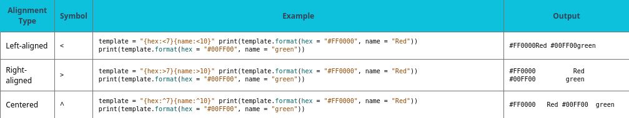
Table 8.2 String alignment formatting.

Slide 19
8.4 String formatting
The format() method can be used to format numerical values.
Numerical values can be padded to have a given minimum length, precision, and sign character.
The syntax for modifying numeric values follows the {[index]:[width][.precision][type]} structure.
In the given syntax,
The index field refers to the index of the argument.
The width field refers to the minimum length of the string.
The precision field refers to the floating-point precision of the given number.
The type field shows the type of the input that is passed to the format() method. Floating-point and decimal inputs are identified by "f" and "d", respectively. String values are also identified by "s".

Slide 20
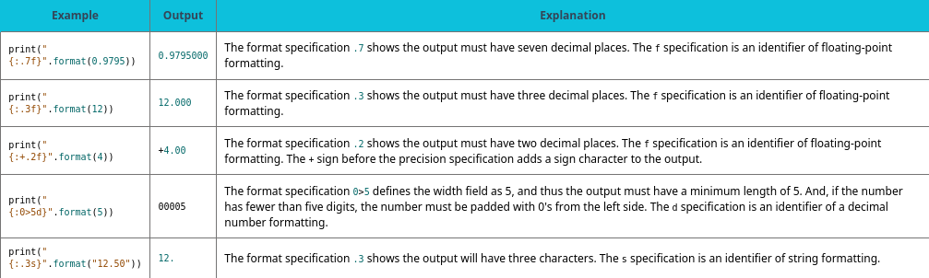
Table 8.3 Numerical formatting options.
The table below summarizes formatting options for modifying numeric values.

Slide 21
8.5 Splitting/joining strings
Learning Objectives
Use the split() method to split a string into substrings.
Combine objects in a list into a string using join() method.

Slide 22
8.5 Splitting/joining strings
A string in Python can be broken into substrings given a delimiter. A delimiter is also referred to as a separator.
The split() method, when applied to a string, splits the string into substrings by using the given argument as a delimiter.
Ex: "1-2".split('-') returns a list of substrings ["1", "2"].
When no arguments are given to the split() method, blank space characters are used as delimiters.
Ex: "1\t2\n3 4".split() returns ["1", "2", "3", "4"].

Slide 23
8.5 Splitting/joining strings
The join() method is the inverse of the split() method: a list of string values are concatenated together to form one output string.
When joining string elements in the list, the delimiter is added in-between elements.
Ex: ','.join(["this", "is", "great"]) returns "this,is,great"

Slide 24
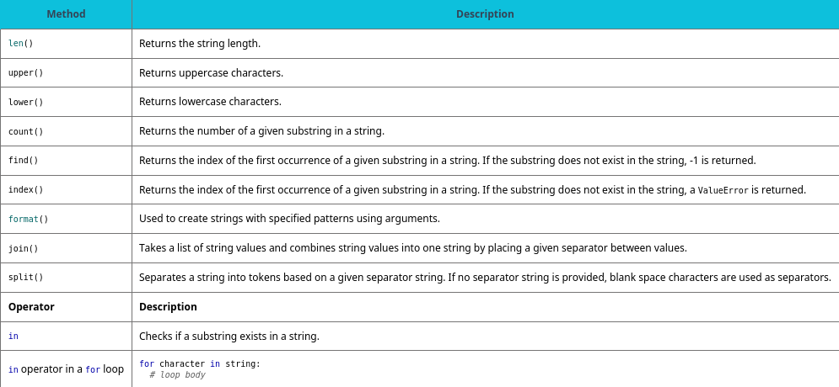
Table 8.4 Chapter 8 reference.

Slide 25
This ancillary resource is licensed under a Creative Commons Attribution-NonCommercial-ShareAlike 4.0 (CC BY NC-SA) license; it may be distributed, remixed, built upon for noncommercial purposes only, and must be attributed to OpenStax and redistributed under the same license.

